Slide 1

DIABETES DATA Analysis
Sylvester Brown
Regis University
Practicum II

Slide 2
Introduction

Slide 3
Purpose of Project
Showcase
Data Exploration
Visualization
Machine learning

Slide 4
DIABETES Dataset
Dataset: Diabetes
Kaggle.com
https://www.kaggle.com/rahulsah06/machine-learning-for-diabetes-with-python
Rahul
768 patients

Slide 5
variables
Pregnancies
Glucose
Blood Pressure
Age
Skin Thickness
Insulin
BMI
Outcome

Slide 6
Focus of Analysis
What factors are best for predicting that someone has diabetes?
Which machine learning model is best for predicting the outcome?

Slide 7
Data Analysis

Slide 8
MISSING Values
Glucose
Blood Pressure
Skin Thickness
Insulin, and BMI
ZEROS
NAN
Median

Slide 9
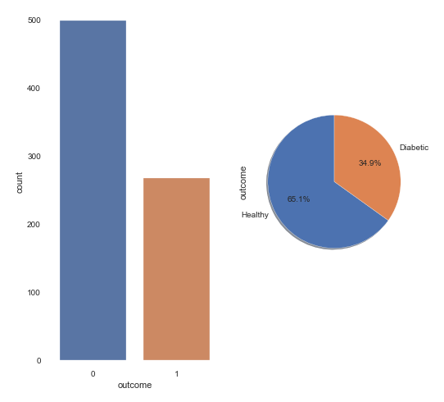

Slide 10
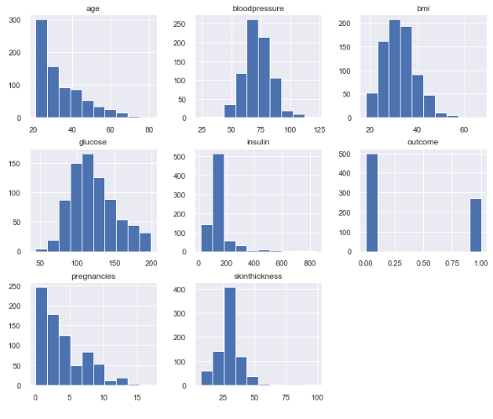
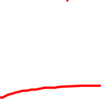
OBSERVATION
Glucose, Blood Pressure, BMI are normally distributed
Pregnancies, Insulin, and Age are rightly skewed.

Slide 11
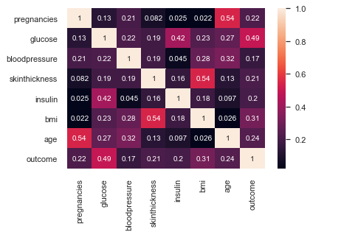
CORRELATION PLOT
Most correlated = glucose
Next = BMI, insulin and age
pregnancy to age, insulin to glucose, BMI and skin thickness, age and glucose.

Slide 12
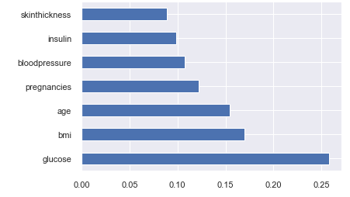
Attribute importance
Model = ExtraTreesClassifier

Slide 13
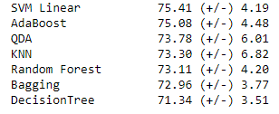
Machine Learning models

Slide 14
Best parameters
Used Grid Search
Best Accuracy
C = 0.01
Kernel = Linear

Slide 15
Optimized SVM linear model
Accuracy = 76%
 | Positive | Negative
Positive | TP = 85 | FP = 14
Negative | FN = 22 | TN = 33

Slide 16
Attribute importance – random numbers
Seed = 42
Integers = 10 to 40
Model = ExtraTreesClassifier

Slide 17
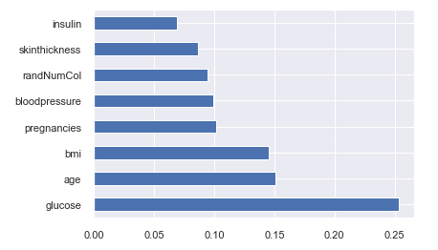

Slide 18
Optimized model – feature importance
Accuracy = 78%
 | Positive | Negative
Positive | TP = 85 | FP = 14
Negative | FN = 20 | TN = 35

Slide 19
Other Resources Used
Used "Pandas for Everyone' by Daniel Chen
https://www.kaggle.com/sagira/logistic-regression-math-behind-without-sklearn
https://www.kaggle.com/kwisatzhaderach/simple-mlp-approach
https://www.kaggle.com/aljojose/pima-indians-diabetes-my-first-project
https://towardsdatascience.com/feature-selection-techniques-in-machine-learning-with-python-f24e7da3f36e
https://www.kaggle.com/saurav9786/eda-makes-sense

Slide 20
QUESTIONS ?

